Slide 1

“From Law to Faith:
Our New Status in Christ”
3:23 – 4:11
Week 8
9 March 2022

Slide 2

Galatians Overview
The law served to keep the Children of God under guard, kept for the faith which would afterward be revealed. To put it another way, it was like a tutor leading them to Christ where they could be justified by faith. Once faith had arrived, the tutor was no longer over them (3:23-25).
Paul then proceeds with a practical argument to prove we are justified by faith in Christ, which will be continued on into chapter four. Through faith they have become sons of God in Christ, for in being baptized into Christ they had put on Christ (3:26-27). Being in Christ, they are now one in Him, with all racial, social, and sexual distinctions removed as it pertains to salvation (3:28).

Slide 3
Galatians Overview
Being in Christ also makes them Abraham's seed and thereby heirs according to the promise God made to him (3:29).
Chapter three ended with Paul making a practical argument, that by faith they had become the sons of God, the true seed of Abraham and heirs of the promise, when they put on Christ in baptism.
In chapter four, Paul continues and concludes his defense of the gospel of justification by faith in Christ, in contrast to seeking justification by the works of the Law. The practical argument continues in the first part of chapter four as Paul describes the condition of those under the Law prior to the coming of Christ.

Slide 4
Galatians Overview
They were “children,” and really no different than slaves. But when Christ came, He redeemed those under the Law and made it possible for them to receive the adoption as “sons.”
A special blessing of this sonship was receiving the Spirit in their hearts, and now they are no longer as a slave but as a son and an heir of God through Christ (4:1-7).
Paul wondered why they wanted to turn back to the weak and useless rules that enslaved them in the past. Finally, Paul was worried that they would return to following special days, months, seasons, and years. Paul’s fear was that his mission to them was in vain; a waste of time (4:8-11).

Slide 5

From Law to Faith:
Our New Status in Christ

Slide 6
Galatians 3:23 – 24
²³Before the coming of this faith, we were held in custody under the law, locked up until the faith that was to come would be revealed. ²⁴So the law was our guardian until Christ came that we might be justified by faith.

Slide 7
Galatians 3:23 – 24
Paul uses two analogies for the Law in these two verses—the jailer and the tutor. Before we received the gracious gift of faith, the Law kept sinners “in custody.” Now, there are two types of guards (jailers)—one positive and the other negative.
On the positive side, a guard may be positioned to protect us, as a bodyguard might prevent us from being harmed. If this were Paul’s meaning, the Law would serve as a rule to keep us from danger.
On the negative side, a guard may be positioned to hold us prisoner, as a jailer would prevent us from escaping a dungeon. In that case, the Law would keep us from true freedom.

Slide 8
Galatians 3:23 – 24
From the viewpoints of both the history of redemption and through all times in the area of individual salvation, only saving faith unlocks the door of the prison where the law keeps men bound: “kept under guard by the law.”
Here, Paul personifies the law as a “guard or jailer” of guilty, condemned sinners, on death row awaiting God’s judgment.
Again, Paul was looking at the coming of Christ, historically and at each believer’s salvation, individually. Faith in Christ alone releases people from bondage to law, whether the Mosaic law, or the law written on the hearts of Gentiles.

Slide 9
Galatians 3:23 – 24
The Greek word “pedagogue” translated as “schoolmaster” or “tutor” denotes a slave whose duty it was to take care of a child until adulthood. The “tutor” escorted the children to and from school and watched over their behavior at home.
Tutors were often strict disciplinarians, causing those under their care to yearn for the day when they would be free from their tutor’s custody.
The law was our tutor which, by showing us our sins, was escorting us to Christ. More precise, the Law did not lead us to Christ but that it was the disciplinarian until Christ came. The reign of Law has ended, that the faith in Christ has delivered believers from the protective custody of the prison and the harsh discipline of the pedagogue.

Slide 10
Galatians 3:23 – 24
Here is Paul’s point: Before faith came, we were held in prison by our jailer, the Law. Before faith came, we were held under strict discipline by our custodian (pedagogue), the Law.
For us to return to these would be like a freed convict rushing back to the prison cell day after day or a high school graduate asking his strict childhood nanny for permission to go to the bathroom.
However, the Law, as both jailer and pedagogue, did its job—to “lead us to Christ” so we would be “justified by faith” (3:24).

Slide 11
Galatians 3:25 – 27
²⁵Now that this faith has come, we are no longer under a guardian. ²⁶So in Christ Jesus you are all children of God through faith, ²⁷for all of you who were baptized into Christ have clothed yourselves with Christ.

Slide 12
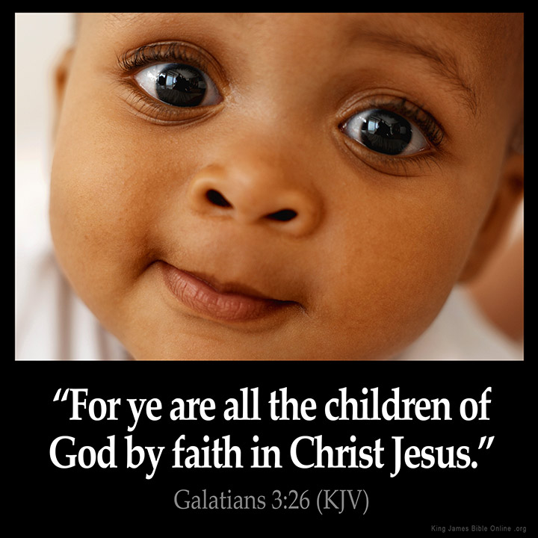

Slide 13
Galatians 3:25 – 27
Through faith in Jesus Christ, believers have come of age as God’s children. Thus, they are no longer under the tutelage of the law, although they are still obligated to obey God’s holy and unchanging righteous standards which are now given authority in the new covenant of grace (3:25).
While God is the Father of all people in a general sense because He created them, only those who have put their faith in Jesus Christ are God’s true spiritual children.
Unbelievers are the children of Satan . . . John 8:44 > “Ye are of your father the devil, and the lusts of your father ye will do.”

Slide 14
Galatians 3:25 – 27
All who believe in Christ become sons of God. The change in person from the first “you” to the second “you” indicates that Paul turned from looking at Israel as a nation to address the Galatian believers. Under the dispensation of Law, as seen in 3:24, the Law was a discipling pedagogue, and those under its supervision were regarded as children.
However, now that Christ had come, the Galatian believers were adult sons through faith and were no longer under a Jewish slave-guardian. Why should they seek to revert to their inferior status?

Slide 15
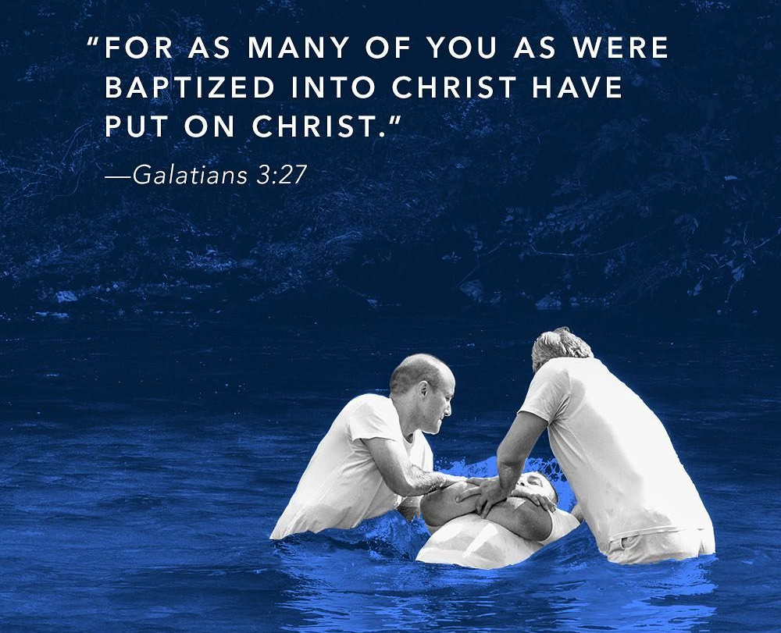

Slide 16
Galatians 3:25 – 27
The exalted position of “sons of God” is explained in 3:27 to involve a living union with Christ brought about by being baptized into Christ. This is the baptism of (or in) the Holy Spirit, which according to Paul, joins all believers to Christ and unites them within the church, Christ’s body.
This union with Him means being clothed with Christ. In the Roman society when a youth came of age he was given a special toga which admitted him to the full rights of the family and state and indicated he was a grown-up son.
So the Galatian believers had laid aside the old garments of the Law and had put on Christ’s robe of righteousness which grants full acceptance before God. Who would want to don again the old clothing?

Slide 17
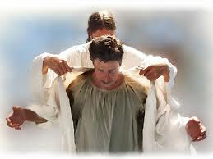

Slide 18
Galatians 3:28 – 29
²⁸There is neither Jew nor Gentile, neither slave nor free, nor is there male and female, for you are all one in Christ Jesus. ²⁹If you belong to Christ, then you are Abraham’s seed, and heirs according to the promise.

Slide 19
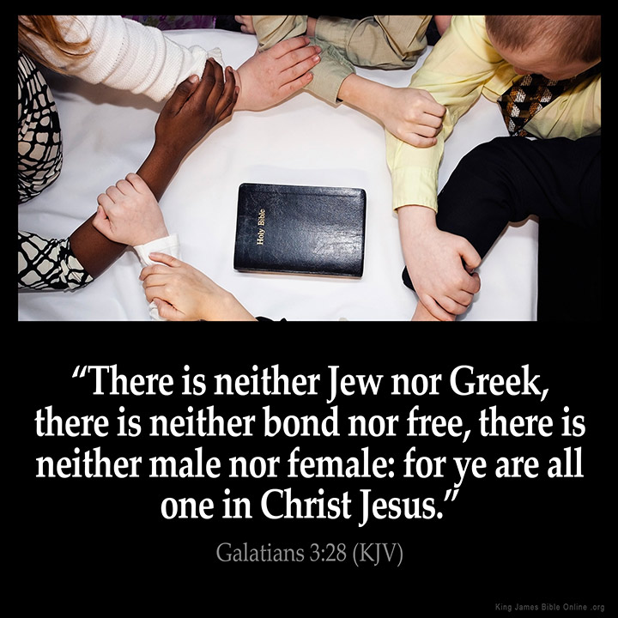

Slide 20
Galatians 3:28 – 29
Since all believers became one with each other, human distinctions lose their significance. None is spiritually superior over another. That is, a believing Jew is not more privileged before God than a believing Gentile; a believing slave does not rank higher than a believing free person; a believing man is not superior to a believing woman.
Paul cut across these distinctions and stated that they do not exist in the body of Christ so far as spiritual privilege and position are concerned. Elsewhere, while affirming the coequality of man and woman in Christ, Paul did nonetheless make it clear that there is a headship of the man over the woman (cf. 1Cor 11:3) and that there are distinctions in the area of spiritual service (cf. 1Tim 2:12).

Slide 21
Galatians 3:28 – 29
Believers in Christ are Abraham’s seed. As Paul previously stated, Christ is the Seed of Abraham (3:16, 19); therefore being in Christ makes a believer a part of that seed and an heir of the promise to Abraham.
Any discussion of the seed of Abraham must first take into account his natural seed, the descendants of Jacob in the 12 tribes. Within this natural seed there is a believing remnant of Jews who will one day inherit the Abrahamic promises directed specifically to them.

Slide 22
Galatians 3:28 – 29
But there is also the spiritual seed of Abraham who are not Jews. These are the Gentiles who believe and become Abraham’s spiritual seed. They inherit the promise of justification by faith as Paul explained earlier.
To suggest, as Amillennialists do, that Gentile believers inherit the national promises given to the believing Jewish remnant—that the church thus supplants Israel or is the “new Israel”—is to read into these verses what is not there.
All believers are heirs of the spiritual blessing that accompanied the Abrahamic Covenant—justification by faith.

Slide 23
Galatians 4:1 – 3
¹What I am saying is that as long as an heir is underage, he is no different from a slave, although he owns the whole estate. ²The heir is subject to guardians and trustees until the time set by his father. ³So also, when we were underage, we were in slavery under the elemental spiritual forces of the world.

Slide 24
Galatians 4:1 – 3
Paul expands on the analogy of a child’s coming of age (3:24–26), contrasting believers’ lives before salvation (as children and servants), with their lives after salvation (as adults and sons).
Both Paul’s Jewish and Gentile readers readily understood this imagery, since the Jews, Greeks, and Romans all had a ceremony to mark a child’s coming of age.
The Greek word for child refers to a child too young to talk; a minor, spiritually and intellectually immature and not ready for the privileges and responsibilities of adulthood.

Slide 25
Galatians 4:1 – 3
“Guardians” were slaves entrusted with the care of underage boys, while “trustees” managed their property for them until they came of age (4:2).
Along with the tutor (3:24), they had almost complete charge of the child—so that, for all practical purposes, a child under their care did not differ from a slave.
Paul applies this illustration in order to show the contrast between the believers’ former position and what they now enjoy. Formerly, in their state of spiritual immaturity (when we were children), they were like slaves. The scope of that slavery was described as being under the basic principles (elements) of the world. Both Jew and Gentile were enslaved until Christ came to emancipate them.

Slide 26
Galatians 4:4 – 7
⁴But when the set time had fully come, God sent his Son, born of a woman, born under the law, ⁵to redeem those under the law, that we might receive adoption to sonship. ⁶Because you are his sons, God sent the Spirit of his Son into our hearts, the Spirit who calls out, “Abba, Father.” ⁷So you are no longer a slave, but God’s child; and since you are his child, God has made you also an heir.

Slide 27
Galatians 4:4 – 7
In God’s timetable, when the exact religious, cultural, and political conditions demanded by His perfect plan were in place, Jesus came into the world > “God sent forth His Son . . .” God marks the fact that divine intervention brought hope and freedom to mankind.
As a father set the time for the ceremony of his son becoming of age and being released from the guardians, trustees, and tutors, so God sent His Son at the precise moment to bring all who believe out from under bondage to the law. That the Father sent Jesus into the world teaches His pre-existence as the eternal second member of the Trinity.

Slide 28
Galatians 4:4 – 7
“Born of a woman . . .” This emphasizes Jesus’ full humanity, not merely His virgin birth. Jesus had to be fully God for His sacrifice to be of the infinite worth needed to atone for sin. But, He also had to be fully man so He could take upon Himself the penalty of sin as the substitute for man.
“Made under the law.” Like all men, Jesus was obligated to obey God’s law. Unlike anyone else, however, He perfectly kept that law, fulfilled it, and finally paid its curse. He sinlessness made Him the unblemished sacrifice for sins, who “fulfilled all righteousness.” That is, Jesus perfectly obeyed God in everything. That perfect righteousness is what is imputed to those who believe in Him (4:4).

Slide 29
Galatians 4:4 – 7
The purpose of Christ’s coming was twofold:
FIRST – He came to “redeem those who were under the Law” (4:5). To “redeem” means to buy out of slavery. So Jesus, by His perfect life and sacrificial death, purchased us from the slave block of the Law. Now we’re no longer slaves but sons and daughters of God. Since Christ redeemed and set free those who were under the Law, why should Gentile converts now wish to be placed under it?
SECOND – Christ Incarnation and death secured for believers the full rights of sons (adoption). All the enjoyments and privileges of a mature son in a family belong to those who have entered into the benefits of Christ’s redemptive work.

Slide 30
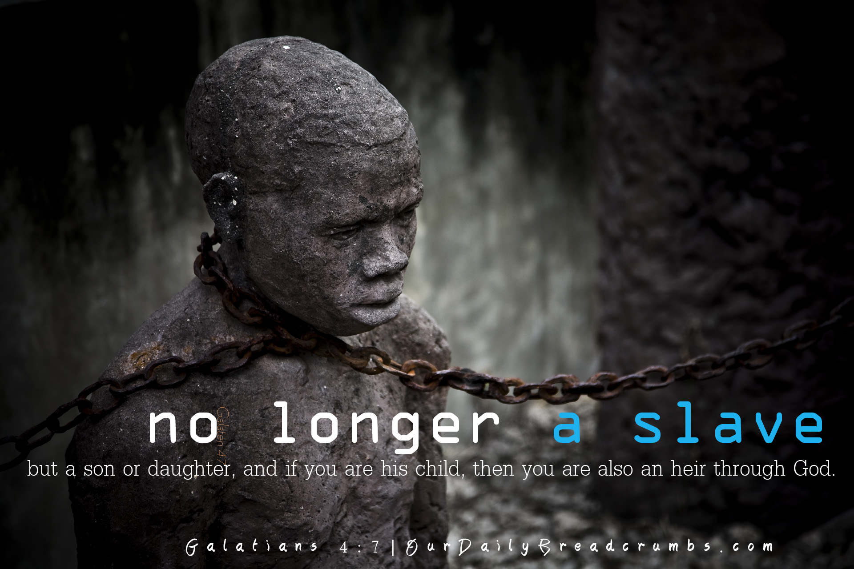

Slide 31
Galatians 4:4 – 7
God the Father not only sent His Son; God also sent the Holy Spirit. Thus the full Trinity is involved in the work of salvation. The Holy Spirit is a gift of God to every believer because of sonship. No sons or daughters lack the Spirit.
Further, the Holy Spirit is present within each believer’s heart to give evidence of one’s position in God’s family. The Holy Spirit moves the believer to pray to God, addressing Him as Abba, Father (cf. Rom. 8:15).
The word “Abba” is the Aramaic word for “Father.” It is a term of endearment used by small children in addressing their fathers. It is appropriate to see its similarity to the English word “Daddy.” Used by Christ (cf. Mark 14:36), this familiar form indicates intimacy and trust as opposed to the formalism of legalism.

Slide 32
Galatians 4:4 – 7
To conclude, Paul declared that the Galatians were no longer slaves, but were sons and heirs. The plural forms in 4:6 were replaced by the singular forms in 4:7 thus making the application to the reader direct and personal.
In God’s family, sonship carries with it heirship . . . (cf. Rom 8:17 > “And if children, then heirs; heirs of God, and joint-heirs with Christ; if so be that we suffer with him, that we may be also glorified together.”
All of these blessings of the triune God confirm the reality that we are no longer slaves but heirs (4:7).

Slide 33


Slide 34
Galatians 4:8 – 11
⁸Formerly, when you did not know God, you were slaves to those who by nature are not gods. ⁹But now that you know God—or rather are known by God—how is it that you are turning back to those weak and miserable forces? Do you wish to be enslaved by them all over again? ¹⁰You are observing special days and months and seasons and years! ¹¹I fear for you, that somehow I have wasted my efforts on you.

Slide 35
Galatians 4:8 – 11
Our inheritance include justification; complete forgiveness of sins; immediate, unlimited, and unconditional access to the Father; membership in Christ’s church; the indwelling of the Holy Spirit; the promise of eternal life; and future bodily resurrection (to name only a few).
That’s quite an inheritance—and all of it free of charge! None of it is deserved, yet all of it has been bestowed upon us “by grace through faith.” The Galatian Christians had come so far. At one time they were ignorant of God, slaves to idolatry (4:8); but by God’s grace they had come to know God in a personal, intimate way. Why then, Paul wonders, would they return to the “weak and miserable forces” (elemental things) becoming enslaved all over again (4:9)?

Slide 36
Galatians 4:8 – 11
By following the Judaizers’ legalistic prescription for living the Christian life, the Galatians were backsliding into slavery. In addition to circumcision, the Judaizers were trying to impose the strict observance of the Jewish calendar (4:10).
In the Law, God had given the Sabbath, festivals, and celebrations to keep the Jewish people focused on Him, but they were never meant to save them—or anyone! By requiring the Gentile Galatian believers to observe these things, the Judaizers were adding works to faith, mixing God’s old covenant with His new covenant.

Slide 37
Galatians 4:8 – 11
So exasperated was Paul with the Galatians that he wondered if he had expended all his effort in evangelism and discipleship in vain (4:11). This isn’t to say that Paul thought the Galatians who had truly trusted Christ were in danger of losing their salvation. Rather, the backsliding of the Galatians into legalism meant that Paul virtually had to start over with their discipleship, teaching them once again the basics of the gospel message—that grace is the way to life and the way of life.
Let’s not allow the Galatians’ folly to become our own. Let’s stop trying to earn the approval of our Father, who has already accepted us—and adopted us—in Christ Jesus. Let us set aside the distractions of legalism and cry out, “Abba, Father!” as grateful sons and daughters, not fearful slaves.

Slide 38

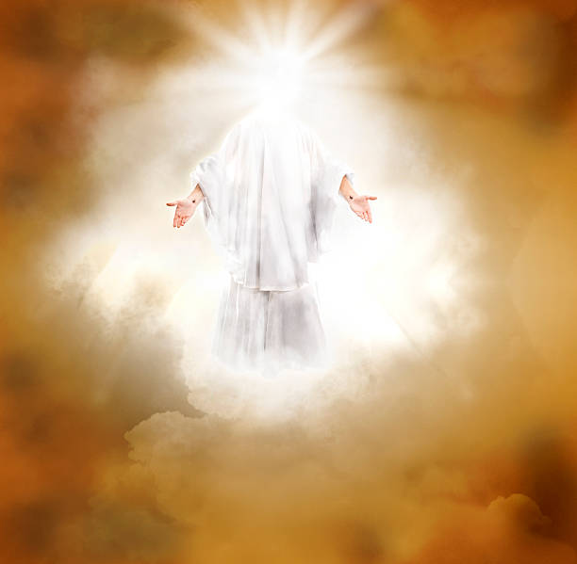

Slide 39
NEXT CLASS – 16 March 2022
Book of Galatians
Before next class, read the below verses in the KJV and the NIV, plus one additional versions of the Bible, i.e., NRSV, NLT, NKJV, etc …
Chapter 4:12 – 20
“Caring Enough to Tell the Truth”
EBC Website for Handouts
https://bit.ly/surveyofpaulineepistles

